Slide 1
Chapter 6 Process Synchronization

Slide 2
Outline
Background
The Critical-Section Problem
Peterson’s Solution
Hardware Support for Synchronization
Mutex Locks
Semaphores
Monitors
Liveness
Lock-free programming
Evaluation

Slide 3
Background
Example: 請寫一個producer-consumer的程式
Producer produces items
Consumer consumes items
The buffer, in, out and counter are shared between producer/consumer
Producer and consumer may be processes
Buffer, in, out, and counter are in their shared memory (IPC)
Or Producer and consumer may be threads in the same process
Buffer, in, out, and counter are global variables

Slide 4
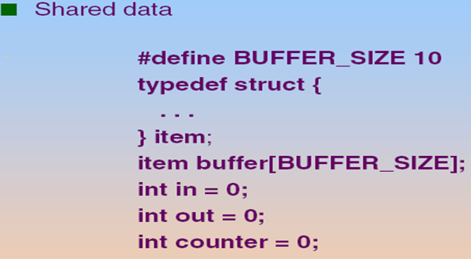
資料結構
out
counter = 4
in

Slide 5
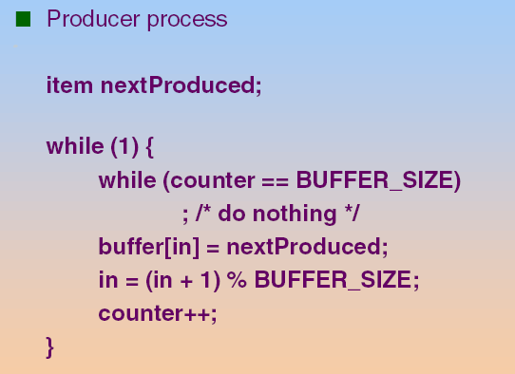
程式碼: Producer Process/Thread

Slide 6
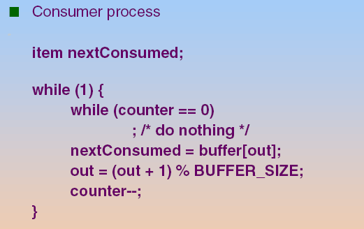
程式碼: Consumer Process/Thread

Slide 7
然而, 上述的程式有Bug!
Q: Bug在哪裡呢?

Slide 8
Background
The “counter++” and “counter--” is compiled to a sequential of CPU instructions
Then, these CPU instructions are executed in some arbitrary order.
As shown in the following slide
“counter++” maybe compiled as
“counter--” maybe compiled as
mov eax, counter
inc eax
mov counter, eax
mov ebx, counter
dec ebx
mov counter, ebx

Slide 9
可能的執行結果(Cont.)
Assume that initially counter = 5
Producer Thread | Consumer Thread | eax (in CPU) | ebx (in CPU) | counter | eax_P (in P’s PCB) | ebx_C (in C’s PCB)
mov eax, counter | --- | 5 |  | 5
inc eax | --- | 6 |  | 5
--- | mov ebx, counter |  | 5 | 5 | 6
--- | dec ebx |  | 4 | 5 | 6
mov counter, eax | --- | 6 |  | 6 |  | 4
--- | mov counter, ebx |  | 4 | 4

Slide 10
你看的出來問題在哪裡嗎?

Slide 11
結論: Concurrent access to shared data may result in data inconsistency

Slide 12
注意: 不是每一次執行都會出錯

Slide 13
可能的執行結果(Cont.)
Assume that initially counter = 5
Producer Thread | Consumer Thread | eax (in CPU) | ebx (in CPU) | counter
mov eax, counter | --- | 5 |  | 5
inc eax | --- | 6 |  | 5
mov counter, eax |  |  |  | 6
--- | mov ebx, counter |  | 6 | 6
 | dec ebx | 5 |  | 6
--- | mov counter, ebx |  | 5 | 5

Slide 14
Race Condition
Race condition:
Several processes concurrently access and manipulate the shared data
Outcome relies on the particular order in which the access takes place

Slide 15
複習: 第三章 IPC
Comparisons
Message passing
Useful for exchanging smaller amounts of data (see the following slide)
Easier to implement
Slower: requires system calls for sending/receiving messages (via memory copying)
No conflict need to be avoided (introduced in Chapter 6)
Shared memory (see the following slide)
Faster: requires no system calls when reading/writing data
But need protection and synchronization (introduced in Chapter 6)

Slide 16
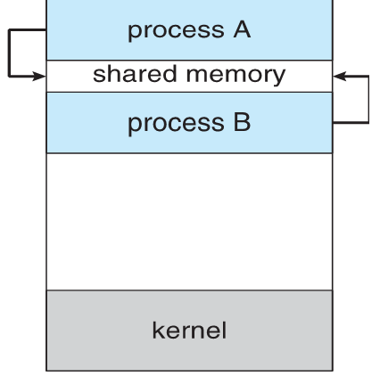
複習: Shared Memory

Slide 17
複習: 在第四章, 我們提到threads共享data section有時候會出問題
第六章會介紹

Slide 18
複習: 第四章提到Nonpreemptive v.s Preemptive
Nonpreemptive or cooperative scheduling
When scheduling takes place only under 1 and 4
Process keeps the CPU until it releases the CPU
Bad for time-sharing system (see the following slide)
Preemptive scheduling
Scheduling takes place under all the circumstances (1 to 4)
A process having obtained CPU may be forced to release CPU
A cost associated with shared data access
Addressed in Chapter 6

Slide 19
複習: 第四章提到Approaches to Multiple-Processor Scheduling (Cont.)
Organizations of the ready queue in SMP
A common ready queue, or
Need to protect the queue (addressed later)
Accessing the queue is a performance bottleneck
Each processor has its private ready queue
Good
Does not have the protection problem
Allow more efficient use of cache memory (addressed later)
Bad
Workload of varying size ⇨ solved by load balance (addressed later)
Most commonly used

Slide 20
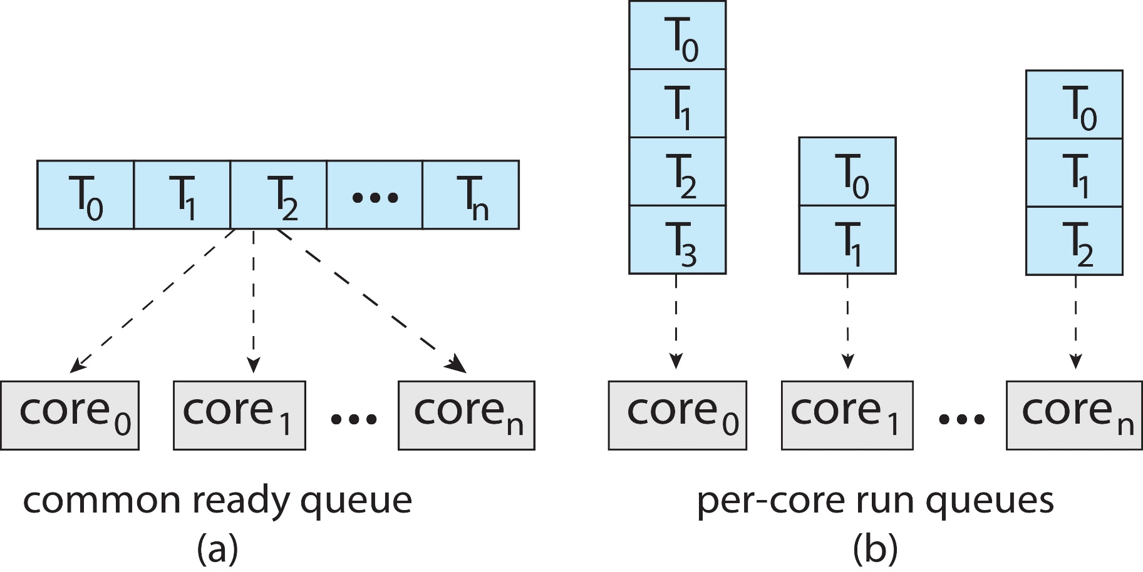
Organizations of Ready Queue in SMP

Slide 21
Q: 怎麼辦呢?
Hint : 觀察前面兩個不同的執行流程(P.9和P.13)

Slide 22
Q: 怎麼辦呢?
Sol.: Process synchronization and coordination Ensure only one process at a time can manipulate the shared data

Slide 23
Outline
Background
Critical-Section
Peterson’s Solution
Hardware Support for Synchronization
Mutex Locks
Semaphores
Monitors
Liveness
Lock-free programming
Evaluation

Slide 24
Critical Section
n processes all competing to use some shared data
Each process has a code segment in which the shared data is accessed.
This segment is called a critical section (CS)
See the following slide
Goal: 為了解決race condition的問題
When one process is executing in its critical section
No other processes are executing in their critical sections at the same time

Slide 25
Critical Section Example
Critical Section

Slide 26
Q: 如何實現上述的目標?
Ans: 一定要修改程式碼

Slide 27
Q: 改在哪裡呢?
Ans: 一定是Critical Section前後

Slide 28
The Critical Section Problem (Cont.)
To accomplish the goal, we need to modify the original code.
Before the CS, each process requests to use the critical sections exclusively: entry section
After the CS, each process releases the request: exit section
The remaining code is the remainder section

Slide 29
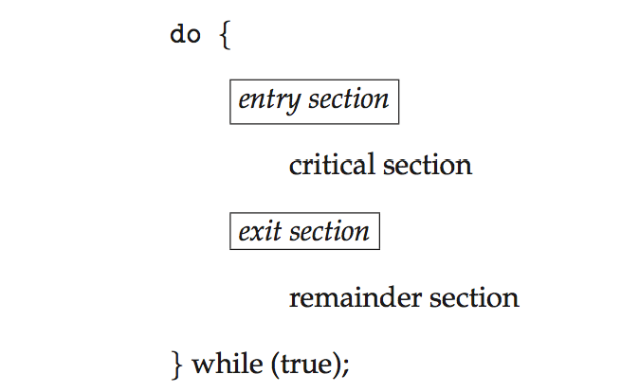
General Structure of a Typical Process
New Code
New Code
General structure of process P_{i}

Slide 30
問題：如何撰寫這兩段程式碼？
Hint: 先理解這兩段程式碼的要求

Slide 31
Solution to Critical-Section Problem
A solution should satisfy the following requirements
1. Mutual Exclusion
At any time, at most one process can be in its critical section (CS)
2. Progress:
If no process is executing in its CS and there exist some processes that wish to enter their CS…
Only those processes that are not executing in their remainder sections (i.e., in entry- or exit-sections) can participate in deciding which process will enter its critical section next (不相干者不參與決策)
And the selection of the processes that will enter the critical section next cannot be postponed indefinitely. (see the following slide)
3. Bounded Waiting
After a process has made a request to enter its CS and before that request is granted
A bound must exist on the number of times that other processes are allowed to enter its critical sections
Guarantee the process will be selected to enter its CS
Otherwise the process will suffer from starvation

Slide 32
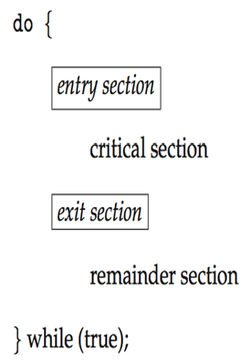

Slide 33
Q: 那到底Entry Section和Exit Section的程式碼要如何寫呢?
本章要學習的!

Slide 34
Solutions to Race Conditions
Software solutions
Peterson’s solutions
Hardware solutions
Rely on some special machine instructions
Operation System solutions
Provide some functions and data structures to the programmer
Built upon the hardware solutions
Language level solutions
Built upon the OS solutions

Slide 35
Outline
Background
The Critical-Section Problem
Peterson’s Solution
Hardware Support for Synchronization
Mutex Locks
Semaphores
Monitors
Liveness
Lock-free programming
Evaluation

Slide 36
Peterson’s Solution
Not guaranteed to work on modern architectures!
Discussed later
Two processes solution
The two processes share two variables:
int turn;
Indicate whose turn it is to enter the critical section
Boolean flag[2]
Indicate if a process is ready to enter the critical section.
flag[i] = 1, implies that process P_{i} is ready to enter CS

Slide 37
Peterson’s Solution
do {
flag[i] = TRUE;
turn = j; // you first
while ( flag[j] && turn == j);
CRITICAL SECTION
flag[i] = FALSE; // exit
REMAINDER SECTION
} while (TRUE);
Entry Section
Exit Section

Slide 38
Peterson’s Algorithm Global View
Process P0:
Do {
flag[0]:=true;
// P0 wants in
turn:= 1;
// P0 gives a chance to P1
while
(flag[1]&&turn=1){};
CS
flag[0]:=false;
// P0 no longer wants in
RS
While (1);
Process P1:
Do {
flag[1]:=true;
// P1 wants in
turn:=0;
// P1 gives a chance to P0
while
(flag[0]&&turn=0){};
CS
flag[1]:=false;
// P1 no longer wants in
RS
While (1);

Slide 39
讓我們看一個例子

Slide 40
P0 | P1 | turn
flag[0]:=true; | ---
turn:= 1; | --- | 1
--- | flag[1]:=true;
 | turn:= 0; | 0
while(flag[1]&&turn=1){};
CS
 | while(flag[0]&&turn=0){};
CS
flag[0]:=false; ……
 | while(flag[0]&&turn=0){};
 | CS

Slide 41
Q1: In P0(P1), why set turn to 1 (0)?
Hint: 看看不禮讓的結果
(see the following slide!)

Slide 42
Question 1 : In P0(P1), Why set turn to 1 (0)?
P0 | P1 | turn
flag[0]:=true; | ---
turn:= 0; | --- | 0
--- | flag[1]:=true;
 | turn:= 1; | 1
while(flag[1]&&turn=1){};
 | while(flag[0]&&turn=0){};
 | CS
 | flag[1]:=false; RS
 | // P1 wants to enter again flag[1]:=true; turn:= 1;
 | while(flag[0]&&turn=0){};
 | CS

Slide 43
Q: 你看的出來上述程式錯在哪裡嗎?
Ans: violate bounded waiting

Slide 44
再看另外一個執行順序

Slide 45
Question 1 : In P0(P1), Why set turn to 1 (0)?
P0 | P1 | turn
flag[0]:=true; | ---
turn:= 0; | --- | 0
while(flag[1]&&turn=1){};
CS
 | flag[1]:=true;
 | turn:= 1; | 1
 | while(flag[0]&&turn=0){};
 | CS

Slide 46
Q: 你看的出來上述程式錯在哪裡嗎?
Ans: violate mutual exclusion

Slide 47
注意: 不是每一次執行都會出錯 (違反Bounded Waiting或是Mutual Exclusion)
你可以自己舉個例子嗎?

Slide 48
Q2: Is it possible to change the first two statements?
Hint: 試試看 (see the following slide!)

Slide 49
Question 2 : Is it possible to change the first two statements?
P0 | P1
turn:= 1; | ---
--- | turn:= 0;
--- | flag[1]:=true;
 | while(flag[0]&&turn=0){};
 | CS
flag[0]:=true; | ---
while(flag[1]&&turn=1){}; | ---
CS

Slide 50
你看的出來上述程式錯在哪裡嗎?
Ans: violate mutual exclusion

Slide 51
注意: 不是每一次執行都會出錯 (違反Mutual Exclusion)
你可以自己舉個例子嗎?

Slide 52
Q3: 你看得出來flag[]和turn本身可能也有問題嗎?
Hint: 它們也是共享變數啊~

Slide 53
Peterson 演算法的假設
Peterson 的演算法假設：
每次讀或寫turn和flag都是原子操作(atomic operation);
但Peterson演算法在現在多核心的系統可能會有問題
Shown later

Slide 54
Not Guaranteed to Work on Modern Computer Architecture
Peterson’s Solution is not guaranteed to work on modern architectures.
Re-order problem
Cache effect

Slide 55
Not Guaranteed to Work on Modern Computer Architecture
Peterson’s Solution is not guaranteed to work on modern architectures.
Re-order problem
Cache effect

Slide 56
Not Guaranteed to Work on Modern Computer Architecture
In current computers, processors and/or compilers may reorder operations that have no dependencies to improve performance.
Thus, the statements in the Peterson’s solution may be reordered

Slide 57
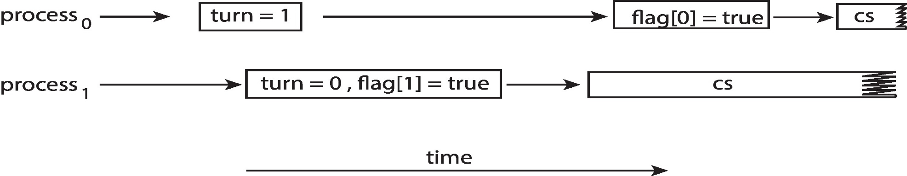
Peterson’s Solution in Current Computer Architecture
Example
Assume the first two statements in the entry section are reordered
Assume that P0 and P1 run on two different processors
前面的例子看過此一問題 (both processes may be in their critical section at the same time!)

Slide 58
Not Guaranteed to Work on Modern Computer Architecture
Peterson’s Solution is not guaranteed to work on modern architectures.
Re-order problem
Cache effect

Slide 59
Not Guaranteed to Work on Modern Computer Architecture
Assume P0 runs at core 1, and P1 at core 2 (see the following slide)
當P0 寫入flag[0] = 1;
Flag[0] is cached in core 1’s L1 cache
Later, when P1 read flag[0]
可能讀到P1的是core 2自己L1 cache的flag[0]或是記憶體的flag[0]
結果都是 flag[0] = 0;

Slide 60
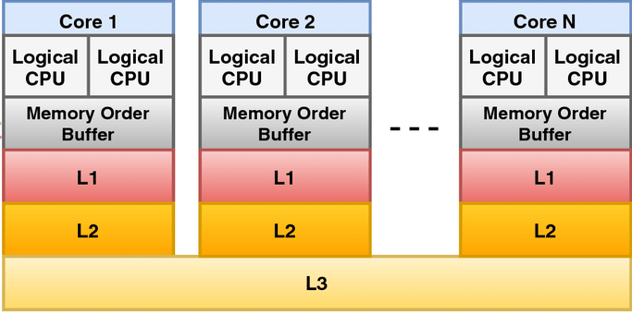
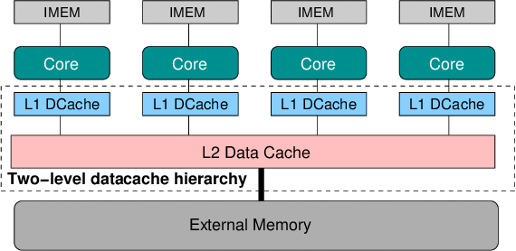
https://www.researchgate.net/figure/Cache-hierarchy-of-an-Intel-processor-the-L3-cache-is-shared-among-available-cores_fig3_321241798

Slide 61
結論: Drawbacks of Software Solutions
Prone to error if not careful
Not guarantee work on modern computer architecture
A two processes solution
Processes that are requesting to enter in their critical sections are busy waiting
Consuming processor time

Slide 62
所以, 我們需要新的方法! Q:誰來提供呢?
Ans: Hardware, OS, and Compiler/Library

Slide 63
Outline
Background
The Critical-Section Problem
Peterson’s Solution
Hardware Support for Synchronization
Mutex Locks
Semaphores
Monitors
Liveness
Lock-free programming
Evaluation

Slide 64
複習： Solutions to Race Conditions
Software solutions
Peterson’s solutions
Hardware solutions
Rely on some special machine instructions
Operation System solutions
Provide some functions and data structures to the programmer
Built upon the hardware solutions
Language level solutions
Built upon the OS solutions

Slide 65
Hardware Support for Synchronization
Three common forms of hardware support:
Memory barriers
Hardware instructions
Atomic variables

Slide 66
Outline
Background
The Critical-Section Problem
Peterson’s Solution
Hardware Support for Synchronization
Memory barriers
Hardware instructions
Atomic variables
Mutex Locks
Semaphores
Monitors
Liveness
Lock-free programming
Evaluation

Slide 67
Memory Barriers (Cont.)
在這個 fence 之前的所有讀寫，必須被全系統（含其他核心）看見，才能繼續執行之後的指令。」
Memory Barrier (屏障), or memory fences (籬笆) :
An instruction (mfence for x86) that enforce an ordering constraint on memory operations issued before and after the barrier instruction
Operations issued prior to the barrier are guaranteed to be performed before operations issued after the barrier.
In fact, it is when a memory barrier instruction is performed, all loads and stores are completed before any subsequent load or store operations are performed (SKIP!)
在這個 fence 之前的所有讀寫，必須被全系統(含其他核心)看見，才能繼續執行之後的指令 (see the following slide)。

Slide 68
Example of Memory Barriers
Place a memory barrier between the first two statements
flag[i] = TRUE;
memory_barrier();
turn = j;

Slide 69
Memory Barriers (Cont.)
所以, 藉由Memory Barrier (屏障), or memory fences (籬笆), 我們可以
Disable out-of-order execution (reordering) of CPUs
提供了L1 cache/記憶體的同步機制

Slide 70
Memory Barriers (Cont.)
所以, 藉由Memory Barrier (屏障), or memory fences (籬笆)
Disable out-of-order execution (reordering) of CPUs
提供了L1 cache/記憶體的同步機制

Slide 71
複習： Peterson’s Solution in Current Computer Architecture
Example
Assume the first two statements in the entry section are reordered
Assume that P0 and P1 run on two different processors
It is possible that both processes are in their critical section at the same time!

Slide 72
如何使用memory barrier來解決上述問題呢?
Ans.: see the following slide

Slide 73
Using Memory Barriers for Peterson’s Solution
Place a memory barrier between the first two statements
flag[i] = TRUE;
memory_barrier();
turn = j;

Slide 74
Memory Barriers (Cont.)
所以, 藉由Memory Barrier (屏障), or memory fences (籬笆)
Disable out-of-order execution (reordering) of CPUs
提供了L1 cache/記憶體的同步機制

Slide 75
複習: Not Guaranteed to Work on Modern Computer Architecture
Assume P0 runs at core 0, and P1 at core 1 (see the following slide)
當P0 寫入flag[0] = 1;
Flag[0] is cached in P0’s L1 cache
Later, when P1 read flag[0]
可能讀到P1自己cache的flag[0]或是記憶體的flag[0]
結果都是 flag[0] = 0;

Slide 76
https://www.researchgate.net/figure/Cache-hierarchy-of-an-Intel-processor-the-L3-cache-is-shared-among-available-cores_fig3_321241798

Slide 77
如何使用memory barrier來解決上述問題呢?
Ans.: see the following slide

Slide 78
Using Memory Barriers for Peterson’s Solution
Place a memory barrier between the first two statements
flag[i] = TRUE;
memory_barrier();
turn = j;

Slide 79
Peterson’s Algorithm Global View
Process P0:
Do {
flag[0]:=true;
memory_barrier();
turn:= 1;
// P0 gives a chance to P1
while
(flag[1]&&turn=1){};
CS
flag[0]:=false;
// P0 no longer wants in
RS
While (1);
Process P1:
Do {
flag[1]:=true;
memory_barrier();
turn:=0;
// P1 gives a chance to P0
while
(flag[0]&&turn=0){};
CS
flag[1]:=false;
// P1 no longer wants in
RS
While (1);

Slide 80
Memory Barriers
However, memory barriers is low-level operations
Only adopted by kernel developers
Not friendly to user application programmers
Besides, using memory barriers is not enough
只保證不會re-order和解決cache同步的問題
不能完整解決race condition

Slide 81
Outline
Background
The Critical-Section Problem
Peterson’s Solution
Hardware Support for Synchronization
Memory barriers
Hardware instructions
Atomic variables
Mutex Locks
Semaphores
Monitors
Liveness
Lock-free programming
Evaluation

Slide 82
How to Provide Synchronization Tools by Hardware Instruction?
Hint 1: 基本的解法

Slide 83
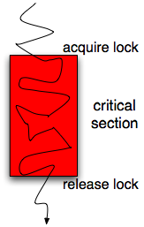
基本想法
最佳的解法: 維護一個變數, 假設是Locks
when lock = 0, set lock = 1, and enter critical section
lock = 0

Slide 84
然而, 上述的程式有問題~
你看得出來嗎?

Slide 85
General Idea (Cont.)
You cannot update the lock by yourself
i.e., You cannot implement the following code
while (lock == 1) ;
lock = 1;
CS
lock = 0;

Slide 86
Why?
Case 1

Slide 87
Why Cannot Access Lock by Yourself ? Case 1
Assume that “lock = 1” is compiled as
mov lock, 1

Slide 88
Case 1 (Cont.)
Assume P1 runs at core 0, and P2 at core 1 (see the following slide)
當P1 寫入lock = 1 (mov lock 1), 進入CS
Lock is cached in P0’s L1 cache
Later, when P2 read lock (判斷lock是否==1?)
可能讀到P1自己cache的lock
Lock也是 = 0, P1將lock設為1, 進入CS

Slide 89
https://www.researchgate.net/figure/Cache-hierarchy-of-an-Intel-processor-the-L3-cache-is-shared-among-available-cores_fig3_321241798

Slide 90
Why?
Case 2

Slide 91
Why Cannot Access Lock by Yourself ? Case 2
Assume P1 runs at core 0, and P2 at core 1
P1 and P2都看到 Lock == 0, 於是同時設成 1。
結果兩個執行緒都「以為」自己拿到鎖並進入CS

Slide 92
lock = 0
P1 | P2
while ( lock == 1); | while ( lock == 1);
Lock = 1; | Lock = 1;
CS | CS

Slide 93
結論
因為Lock is a shared variable
Thus, accessing lock must be synchronized and protected
存取lock本身也是一個critical section
You cannot access lock by yourself~

Slide 94
Q: 怎麼辦呢?

Slide 95
General Idea (Cont.)
Idea: 硬體可以提供特殊的instructions讓我們安全的存取lock(檢查lock的值以及設定lock的值)
Sol.: atomic hardware instructions
test_and_set
compare_and_swap

Slide 96
Atomic Instructions
Modern CPUs provide special atomic instructions even in MP systems
Atomic: non-interrupted
If two atomic instructions are executed simultaneously (each on a different core), they will be executed sequentially in some arbitrary order (shown later)
也會確保cache內容的一致性 (shown later)

Slide 97
第一個instruction是test_and_set
Hint: 你覺得它的定義是什麼呢?

Slide 98
test_and_set Instruction
Definition:
boolean test_and_set (boolean *target)
{
boolean rv = *target;
*target = TRUE;
return rv:
}
Done by a single instruction
Executed atomically
Returns the original value of passed parameter
Set the new value of passed parameter to true

Slide 99
Q: 如何使用test_and_set來解決race condition?

Slide 100
Mutual-Exclusion using test_and_set
A shared Boolean variable lock, initialized to false:
Process P_{i}
do {
while (test_and_set(lock)) ;
critical section
lock = false;
remainder section
}

Slide 101
lock = false
busy waiting
Thread//Process 1 | Thread//Process 2
rv = FALSE, *target(=LOCK)=TRUE, return FALSE | ---
Enter CS, but soon context switch
--- | rv = TRUE, *target (=LOCK)= TRUE, return TRUE
--- | rv = TRUE, *target (=LOCK)= TRUE, return TRUE
--- | rv = TRUE, *target (=LOCK)= TRUE, return TRUE
Exit CRITICAL SECTION | ---
LOCK=FALSE
 | rv = FALSE, *target(=LOCK)=TRUE, return FALSE
 | Enter CRITICAL SECTION

Slide 102
可以解決之前的問題嗎?

Slide 103
複習: Case 1
Assume P1 runs at core 0, and P2 at core 1 (see the following slide)
當P1 寫入lock = 1 (mov lock 1), 進入CS
Lock is cached in P0’s L1 cache
Later, when P2 read lock (判斷lock是否==1?)
可能讀到P1自己cache的lock
Lock也是 = 0, P1將lock設為1, 進入CS

Slide 104
https://www.researchgate.net/figure/Cache-hierarchy-of-an-Intel-processor-the-L3-cache-is-shared-among-available-cores_fig3_321241798

Slide 105
如前述, test_and_set會確保cache內容的一至性
所以, P1寫入lock = 1, 其他核心的lock也會更新為lock= 1,

Slide 106
複習: Case 2
Assume P1 runs at core 0, and P2 at core 1
P1 and P2都看到 Lock == 0, 於是同時設成 1。
結果兩個執行緒都「以為」自己拿到鎖並進入CS

Slide 107
複習: Case 2
lock = 0
P1 | P2
while ( lock == 1); | while ( lock == 1);
Lock = 1; | Lock = 1;
CS | CS

Slide 108
如前述, If two atomic instructions are executed simultaneously (each on a different core) They will be executed sequentially in some arbitrary order
所以, 後一頁的圖不會成立

Slide 109
複習: Case 2
lock = 0
P1 | P2
while ( test_and_set()…) | while ( test_and_set()…)
CS | CS

Slide 110
所以, 真的可以解決前述的問題!

Slide 111
第二個instruction是compare_and_swap
Hint: 你覺得它的定義是什麼呢?

Slide 112
compare_and_swap Instruction
Definition.
int compare_and_swap(int *value, int expected, int new_value)
{
int temp = *value;
if (*value == expected)
*value = new_value;
return temp;
}
Done by a single instruction
If the “value” matches “expected”, write “new_value” into value! Finally, return value

Slide 113
Q: 如何使用compare_and_swap來解決race condition?

Slide 114
Mutual-Exclusion using compare_and_swap
Shared Boolean variable lock initialized to 0
Process P_{i}
do { while (compare_and_swap(&lock, 0, 1) != 0) ;
/* critical section */
lock = 0;
/* remainder section */
} while (true);

Slide 115
lock = 0
Thread/Process 0 | Thread/Process 1 | Thread/Process 2
compare_and_swap()return 0
while ()不成立
CRITICAL SECTION
 | Remainder Section
--- |  | compare_and_swap()return 1
 |  | while ()成立
 |  | compare_and_swap()return 1
 |  | while ()成立……
CRITICAL SECTION
…… |  | ……
busy waiting

Slide 116
不過, 上述使用test_and_set和compare_and_swap的程式都還有bug~
Hint: 不滿足三個條件中的哪一個條件呢?

Slide 117
Bounded-Waiting with test_and_set()
Previous two versions only guarantees mutual exclusion
But do not satisfy bounded-waiting
Pi can enter CS repeatedly
As shown in the next page

Slide 118
lock = 0
Thread/Process 0 | Thread/Process 1 | Thread/Process 2
lock = TRUE, while ()不成立 |  | ---
CRITICAL SECTION
 | Remainder Section
--- |  | lock = TRUE, while ()成立
--- |  | lock = TRUE, while ()成立
 |  | lock = TRUE, while ()成立
CRITICAL SECTION
LOCK = FALSE
Remainder Section;
lock = TRUE, while ()不成立
Enter CRITICAL SECTION Again
 |  | lock = TRUE, while ()成立
 |  | lock = TRUE, while ()成立
 |  | lock = TRUE, while ()成立

Slide 119
Q: 怎麼辦呢?
Hint: 離開CS時檢查是否有其他thread想進入, 如果有, 則讓其中一個進入

Slide 120
Bounded-Waiting with test_and_set()
Solution: in addition to lock, add another DS waiting[n]
boolean waiting[n];
waiting[i]=1; Pi wait to enter CS, 並且先假設自己必須等待
Initialized to false
boolean lock;

Slide 121
Shared Boolean variable lock and wait[i] are initialized to FALSE
Do {
waiting[i] = TRUE; // P_{i} wish to enter CS 並且先假設會被block
while (waiting[i] && TestandSet(&lock)) ; // if waiting[i]=false || lock=false
waiting[i] = FALSE; // => escape the loop
critical section // P_{i} enters CS
j = (i+1)%n; // scan from i+1, i+2, …,n-1, 0, …i-1
while ( (j!= i) && waiting[j] == FALSE) // scan wait[j]
j = (j+1)%n; // select wait[j] = true to enter CS
if ( j == i ) lock = FALSE; // nobody wants to enter CS (as usual)
else waiting[j] = FALSE; // select wait[j] = false to enter CS
// remainder section
} while (TRUE);

Slide 122
你看的出來前面的程式在做什麼嗎?
Hint: see the following slide

Slide 123
Bounded-Waiting with test_and_set()
進入CS有兩個方法
waiting[i] = false;
lock = 0;
假設有10個processes, 目前process 3在CS當中, 當process[3]離開CS, 逐一檢查process 4, 5, 6, 7, 8, 9, 0, 1, 2是否有人要進入CS(waiting[j]=true的)
如果有, say j = 7,直接將waiting[7]設為false
如果都沒有(j=3), 則將lock打開(lock設為0)

Slide 124
lock = false, waiting[0]=false, waiting[1]=false, waiting[2]=false
Thread 0 | Thread 1 | Thread 2
waiting[0]=True | ---
(TetAndSet)return False, Lock=True | ---
waiting[0]=False | ---
CRITICAL SECTION
 | Remainder Section
 |  | waiting[2]=True
 |  | (TetAndSet)return True, Lock=True…
CRITICAL SECTION
j=1; while()成立; j=j+1(=2)
j=2; while()不成立; (waiting[2]=True) 跳開while()迴圈
if 不成立; 執行else waiting[2]=False
REMAINDER SECTION
waiting[0]=True
(TetAndSet)return True,Lock=True… (Cannot Enter Critical Section Again)
 |  | while()不成立(waiting[2]=False)
 |  | waiting[2]=False
 |  | Enter CRITICAL SECTION

Slide 125
However, Using test-and-set and compare-and-swap is still difficult for programmers!

Slide 126
Outline
Background
The Critical-Section Problem
Peterson’s Solution
Hardware Support for Synchronization
Memory barriers
Hardware instructions
Atomic variables
Mutex Locks
Semaphores
Monitors
Liveness
Lock-free programming
Evaluation

Slide 127
Atomic Variables
Instructions such as compare-and-swap and test-and-set are used as building blocks for other synchronization tools.
One tool is an atomic variable
Provides atomic (uninterruptable) updates on basic data types (e.g., integers and booleans).

Slide 128
Atomic Variables (Cont.)
Example: x86 provides a “lock” prefix
Tells the hardware: “don’t let anyone read/write the value until I’m done with it”
See the following slide

Slide 129
Example: Intel Lock Prefix
static inline int fetch_and_add(int* variable, int value)
{
__asm__volatile("lock; xaddl %0, %1"
: "+r"(value), "+m"(*variable) // input+output :
: // No input-only :
: "memory"
);
return value;
}
Adding lock prefix makes “xaddl” instruction executed atomically

Slide 130
Q: 可是我們目前都使用高階語言寫程式, 怎麼辦呢?
Ans: 事實上, 目前高階語言也再包裝CPU提供的compare_and_swap(或是test_and_set), 提供程式設計師更方便使用atomic variable

Slide 131
Atomic Variables (Cont.)
Some high level language, e.g., C++ and Java, also support atomic variables
Provides special atomic data types + special functions for accessing atomic variables
These functions are implemented using compare-and-swap or test-and-set (see the following slide)
For example, the increment() operation on an atomic variable counter
counter is incremented without race condition
increment(&counter);

Slide 132
Using compare_and_swap to Implement atomic variable
void increment(atomic_int *v) { int temp; do { temp = *v; } while (temp != (compare_and_swap(v,temp,temp+1)); }
Implementation of increment() operation

Slide 133
Example: without Atomic Variables (Skip!)
Assume two threads executes “counter++”
Assume initially counter = 5; (The result should be 7, but 6)
Thread 1 | eax | Thread 2 | eax | counter
mov eax, counter | 5 | --- |  | 5
inc eax | 6 | --- |  | 5
--- | --- | mov eax, counter | 5 | 5
--- | --- | inc eax | 6 | 5
mov counter, eax | 6 | --- |  | 6
--- | --- | mov counter, eax |  | 6

Slide 134
Example: with Atomic Variables (Skip!) *counter = 5, calling increment(), the result is 7
Thread 1 | Thread 2
temp = *v (=counter) = 5 | ---
--- | temp = *v (=counter) = 5
--- | compare_and_swap(v, temp, temp+1); // *v (=counter) = temp+1 = 6; return 5
compare_and_swap(v(=6), temp(=5), temp+1); // *v != temp, v = 6, return 6;
temp != 6; while()成立 (busy waiting)
temp = *v (=counter) = 6
 | temp = 5; return 也是5, while ()不成立
 | increment() 完成 Continue to the following instruction
compare_and_swap(v, temp, temp+1); // *v (=counter) = temp+1=7, return 6;
temp == 6; while ()不成立
increment() 完成 Continue to the following instruction

Slide 135
作業系統實驗會有一個Atomic Variable的實驗

Slide 136
Q: 所有的問題都解決了嗎?

Slide 137
Atomic Variables (Cont.)
But, atomic variables do not entirely solve CS problems
Only do a limited set of operations to basic data type
Not enough to synthesize more complicated operations
Example
Consider a red-black tree shared by multiple processes/threads.

Slide 138
Outline
Background
The Critical-Section Problem
Peterson’s Solution
Hardware Support for Synchronization
OS Solution: Mutex Locks
Spin Locks
Semaphores
Monitors
Liveness
Lock-free programming
Evaluation

Slide 139
複習： Solutions to Race Conditions
Software solutions
Peterson’s solutions
Hardware solutions
Rely on some special machine instructions
Operation System solutions
Provide functions and data structures to the programmer
Built upon the hardware solutions
Language level solutions
Built upon the OS solutions

Slide 140
Problems in Previous Approaches
Previous hardware-based solutions are complicated or not enough to application programmers
Solution: OS build a more convenient approach to solve critical section problem
Mutex locks, spin lock, semaphores

Slide 141
複習：基本想法
最佳的解法: 維護一個變數, 假設是Locks
when lock = 0, set lock = 1, and enter critical section
lock = 0

Slide 142
複習： General Idea (Cont.)
But, you cannot update the lock by yourself
i.e., you cannot implement the following code by yourself
Why? Lock is a shared variable
while (lock != 0) ;
lock = 1;
CS
lock = 0;

Slide 143
前面我們看過如何使用Hardware來保護Lock, 但是太複雜了
所以, 我們希望OS幫助我們!

Slide 144
Q: OS如何幫助我們呢?
Ans: 請OS幫我們取得lock和release lock!

Slide 145
Q:結論,怎麼做呢?
Ans: OS提供lock, 以及兩個system calls(acquire()和release())幫我們取得lock和release lock!

Slide 146
Mutex Locks
OS提供一種lock, 稱為mutex (mutual exclusion) lock
A synchronization tool provided by OS
mutex : a boolean variable, 初始值為true
Can only be accessed via two atomic system calls:
acquire() and release()

Slide 147
Q: 那acquire()和release()做什麼呢?

Slide 148
Mutex Locks
acquire() { while ( mutex==false )
; /* busy wait */
mutex = false;;
}
release() {
mutex = true;
}
請OS幫你acquire lock(呼叫acquire()) 以及release lock(呼叫release())

Slide 149
General Idea: Using Mutex Lock
Acquire mutex lock
Release mutex lock

Slide 150
Race Condition Problem Solved by mutex
For n processes, initialize mutex value to 1
Then only 1 process is allowed into CS
acquire(mutex);
// CS
release(mutex);
Remainder section

Slide 151
mutex = 1
Thread 0 | Thread 1
---
acquire() set mutex=false
CRITICAL SECTION
 | acquire()’s while() busy waiting
CRITICAL SECTION
release() set mutex=true
REMAINDER SECTION
 | acquire()’s while() break
 | CRITICAL SECTION
 | release() set mutex=true
 | REMAINDER SECTION

Slide 152
Mutual-Exclusion Implementation with mutex
acquire(M) {
while M == 0
; // no-op
M=0; }
mutex:1
0
Release(M) {
M = 1;
}
process A
process B
process C
busy waiting
busy waiting
acquire(mutex);
// CS
release(mutex);
acquire(mutex);
// CS
release(mutex);
acquire(mutex);
// CS
release(mutex);

Slide 153
Q: 我們可以宣告一個mutex lock, 然後自己存取他嗎? 例如: mutex++; mutex--?

Slide 154
Q: since mutex is a shared variable, acquire() and release() must be atomically. 那OS如何確保acquire()和release()是atomic system calls?
Hint: 利用硬體
Ans: OS uses test-and-set or compare-and-swap to implement above two functions

Slide 155
簡化版的acquire (Skip!)
// acquire: 嘗試用 CAS 把 locked 從 0 改成 1 void acquire(spinlock_t *lk) { while (1) { int expected = 0; // atomic_compare_and_swap: 原子操作 if (__sync_bool_compare_and_swap(&lk->locked, expected, 1)) { __asm__ __volatile__("" ::: "memory"); // memory barrier (acquire) return; // 成功拿到鎖 } // 如果失敗，就一直忙等（自旋） while (lk->locked) { // 在這裡 spin，等鎖可能釋放 } } }

Slide 156
簡化版的release (Skip!)
// release: 把 locked 設回 0
void release(spinlock_t *lk) {
__asm__ __volatile__("" ::: "memory"); // memory barrier (release)
lk->locked = 0;
}

Slide 157
Q: 然而, 前述的mutex定義有一個問題, 什麼問題呢?
Ans: busy waiting

Slide 158
Q: 那怎麼辦呢?

Slide 159
Mutex Implementation
But, above mutex needs busy waiting
To avoid busy waiting:
Put the process to wait, i.e., put in a waiting queue
Each mutex is associated with a waiting queue
Re-define a mutex as a record
typedef struct {
int value; struct PCB *L; } mutex;

Slide 160
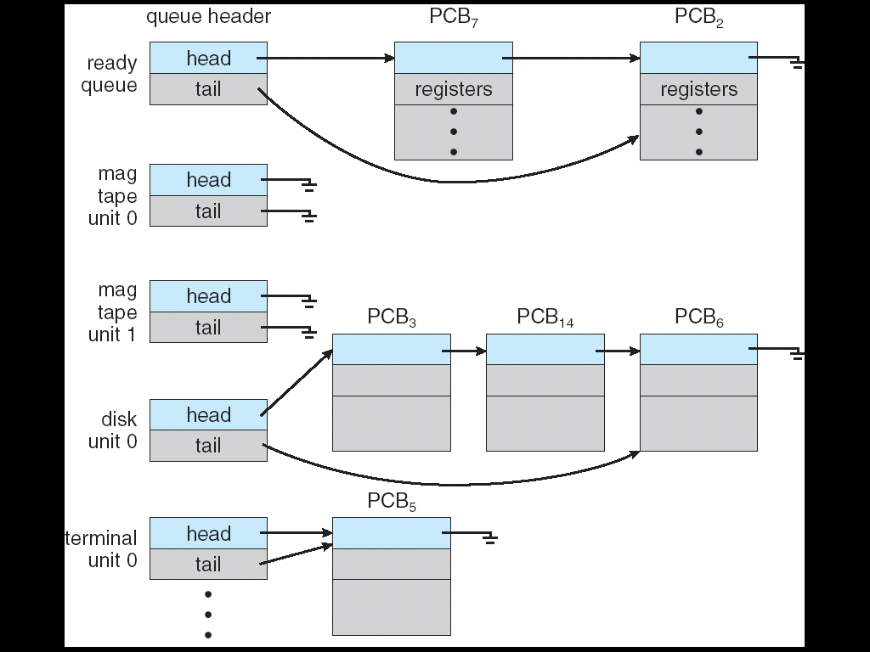
複習：Various Wait Queues
There may be a set of wait queues

Slide 161
New Mutex Locks
acquire() { mutex.value --;
if ( mutex.value < 0 )
add this process to mutex.L;
block;
}
release() {
mutex.value++;
if ( mutex.value <= 0 )
remove a process from mutex.L;
waitup(P);
}

Slide 162
New Mutex Locks
acquire() { mutex.value --;
if ( mutex.value < 0 )
add this process to mutex.L;
block;
}
release() {
mutex.value++;
if ( mutex.value <= 0 )
remove a process from mutex.L;
waitup(P);
}

Slide 163
Mutual-Exclusion Implementation with the New Mutex
release (mutex) {
mutex.value++;
if (mutex.value <= 0)
Wake process from mutex.L
}
signal (mutex) {
mutex.value--;
if (mutex.Value < 0 )
Add process to mutex.L
}
mutex.value: 1
0
-2
-1
mutex.L:
B
C
process A
process B
process C
blocked (waiting)
blocked (waiting)
acquire(mutex);
// CS
release(mutex);
acquire(mutex);
// CS
release(mutex);
acquire(mutex);
// CS
release (mutex);

Slide 164
作業系統實驗會有一個Mutex Lock的實驗

Slide 165
Outline
Background
The Critical-Section Problem
Peterson’s Solution
Hardware Support for Synchronization
OS Solution: Mutex Locks
OS Solution: Spin Locks
Semaphores
Monitors
Liveness
Lock-free programming
Evaluation

Slide 166
前面提到初版的mutex有busy waiting的問題(如下圖)!
但是, busy waiting有時候是好的方法!
Q: 何時是好的方法?

Slide 167
複習: Busy Waiting版本的Mutex Locks
acquire() { while ( mutex==false )
; /* busy wait */
mutex = false;;
}
release() {
mutex = true;
}

Slide 168
Example
舉個例子：看漫畫，如果漫畫在他人手上(漫畫是shared variable)
如果剩下兩頁：busy waiting
如果還很多: sleep

Slide 169
所以, 我們定義一個新的synchronization機制: Spin Lock

Slide 170
Spin Locks
Spinlock
“spin”(旋轉) while waiting the lock, i.e., busy waiting
就是原本busy waiting版本的mutex lock

Slide 171
Q: 那到底何時適合使用Spin Lock呢?

Slide 172
Spin Locks
何時適合使用spin lock?
In MP and if critical section is short
Why?
No context switch overhead and can quickly obtain the lock
See the next slide

Slide 173
Q1: 為什麼只適用於MP電腦?
Ans: 如下頁顯示Single Processor的情形
(你等待, 他就不看漫畫)

Slide 174
In Single Processor
P2 acquire();⇨P2 sleep
P1 release ();
P1 in CS
P2
P1 in CS
P2 in CS
(a)使用sleeping-based mutex lock
P2 acquire();⇨P2 busy waiting
P1 release ();
P1 in CS
P2
P2 busy waiting
P1 in CS
P2 in CS
(b)使用spin lock

Slide 175
Q2: 為什麼只適用於Critical Section短的情形?
Ans: 如下頁顯示

Slide 176
In MP Processor
CS: context switch
P1 acquire();
P1 release ();
CPU₁
P1
P1 in CS(critical section)
P1
(a)P1執行在CPU₁
P2 acquire()⇨P2 blocked
P2 wakeup
CPU₂
P2
CS
P3
CS
P2 in CS
(b)P2執行在CPU₂, 使用mutex
P2 acquire()⇨P2 busy waiting
CPU₂
P2
P2 busy waiting
P2 in CS
(b)P2執行在CPU₂, 使用spin lock

Slide 177
In MP Processor
由上圖, CS(context switch)和busy waiting都是overhead
因為busy waiting的時機 ≈ critical section的時間
Thus, if T(CS + CS) > T(busy waiting)
代表critical section短 (漫畫只剩下兩頁)
使用busy waiting (spin lock)
Else
代表critical section長 (漫畫還有很多很多頁)
使用mutex

Slide 178
再看一個例子

Slide 179
Spinlock Is Only Useful in Short CS and in MP Systems
slock:1
0
spin_lock(M){
while(M==False)
;
M=0;
}
spin_unlock(M){
M=1; }
process A on processor 1
process B on processor 2
spin_lock(spin_lock);
// CS
spin_unlock(spin_lock);
B=B+1;
A=A+1;
spin_lock(spin_lock);
// CS
spin_unlock(spin_lock);
busy waiting

Slide 180
作業系統實驗會有一個Spin Lock的實驗

Slide 181
Outline
Background
The Critical-Section Problem
Peterson’s Solution
Hardware Support for Synchronization
Mutex Locks
Spin Locks
OS Solution: Semaphores
Monitors
Liveness
Lock-free programming
Evaluation

Slide 182
Q: 假設我們有三台印表機, 所以我們希望最多可以同時有三個processes存取印表機
Hint: 將存取printer視為一個critical section,
然後最多有三個processes進入critical sections
Sol.: semaphore

Slide 183
Outline
Background
The Critical-Section Problem
Peterson’s Solution
Hardware Support for Synchronization
Mutex Locks
Spin Locks
OS Solution: Semaphores
Semaphore Definition
Semaphore Usage
Monitors
Liveness
Lock-free programming
Evaluation

Slide 184
Semaphore
Semaphore: a more powerful synchronization tool provided by OS
Semaphore S – integer variable
But, each semaphore is associated with a waiting queue
Thus, each semaphore is in fact a record
typedef struct {
int value; struct PCB *L; } semaphore;
Can only be accessed via two operations, wait() and signal()

Slide 185
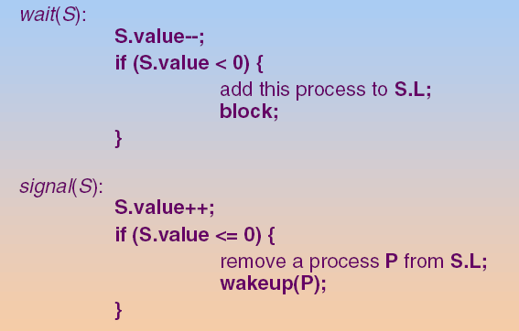
Semaphore

Slide 186
OS 必須確保 no two processes can execute wait() and signal() on the same semaphore at the same time
複習
OS會利用test_and_set或是compare_and_set確保上述條件成立

Slide 187
Semaphore Types
Semaphore
Counting semaphore – unrestricted integer value
Control access to a given resource with N instances
Semaphore value is initialized to N
Binary semaphore – integer value can range only between 0 and 1;
Similar to mutex locks
Binary semaphore is initialized to 1

Slide 188
Outline
Background
The Critical-Section Problem
Peterson’s Solution
Hardware Support for Synchronization
Mutex Locks
Spin Locks
Semaphores
Semaphore Definition
Semaphore Usage
Monitors
Liveness
Lock-free programming
Evaluation

Slide 189
使用semaphore 同樣可以實現mutual exclusion

Slide 190
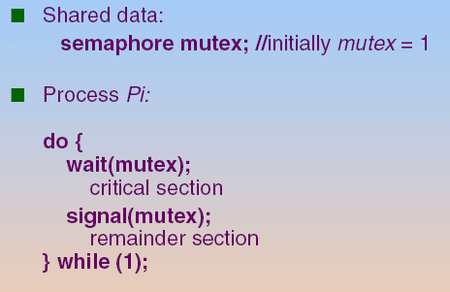
Mutual-Exclusion with Binary Semaphores
For n processes, initialize S value to 1
Then only 1 process is allowed into CS (mutual exclusion)

Slide 191
General Idea: Mutual-Exclusion with Binary Semaphores
Acquire semaphore
Release semaphore

Slide 192
Mutual-Exclusion with Binary Semaphores
wait (S) {
S.Value--;
if (S.Value < 0 )
Add process to S.L
}
singal (S) {
S.Value++;
if (S.Value <= 0)
Wake process from S.L
}
S.value: 1
0
-2
-1
S.L:
B
C
process A
process B
process C
blocked (waiting)
blocked (waiting)
wait(sem);
// CS
signal(sem);
wait(sem);
// CS
signal(sem);
wait(sem);
// CS
signal(sem);

Slide 193
使用 semaphore 也可以做到不同的事情
See the following slides

Slide 194
Using Semaphores to Synchronize Processes
Semaphore can also be used to solve synchronization problems.
Problem:
Two processes: P1 and P2
Statement S1 in P1 needs to be performed before statement S2 in P2
P1: S1;
P2: S2;

Slide 195
Q: 如何實現呢?

Slide 196
Using Semaphores to Synchronize Processes
使用semaphore(或是mutex, spin lock)
假設宣告synch: a semaphore and initialize synch to 0
P1:
S1;
signal(synch);
P2:
wait(synch);
S2;

Slide 197
Using Semaphores to Synchronize Processes
wait (S) {
S.Value--;
if (S.Value < 0 )
Add process to S.L
}
S.value: 0
-1
S.L:
2
process 1
process 2
S1;
signal(synch);
wait(synch);
S2;
blocked

Slide 198
作業系統實驗會有一Semaphore的實驗

Slide 199
Outline
Background
The Critical-Section Problem
Peterson’s Solution
Hardware Support for Synchronization
Mutex Locks
Spin Locks
Semaphores
Language-Level Solution: Monitors
Liveness
Lock-free programming
Evaluation

Slide 200
複習： Solutions to Race Conditions
Software solutions
Peterson’s solutions
Hardware solutions
Rely on some special machine instructions
Operation System solutions
Provide some functions and data structures to the programmer
Built upon the hardware solutions
Language level solutions
Built upon the OS solutions

Slide 201
Outline
Background
The Critical-Section Problem
Peterson’s Solution
Hardware Support for Synchronization
Mutex Locks
Semaphores
Monitors
Monitor Usage
Implementing a Monitor Using Semaphore
Resuming Processes within a Monitor
Liveness
Lock-free programming
Evaluation

Slide 202
Monitor
A high-level abstraction for process synchronization
Found in many programming languages
Concurrent Pascal, Modula-3, uC++, Java...
Monitor: encapsulate private data with public method
Variables can be accessed by only the local procedures
Only one process may be active within the monitor at a time

Slide 203
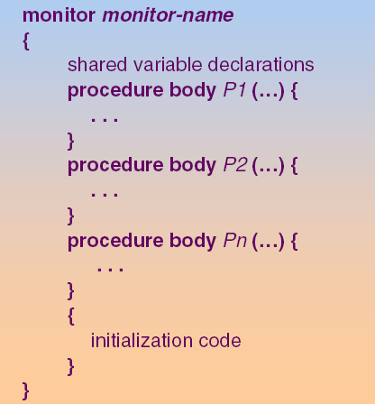
Monitor Structure

Slide 204
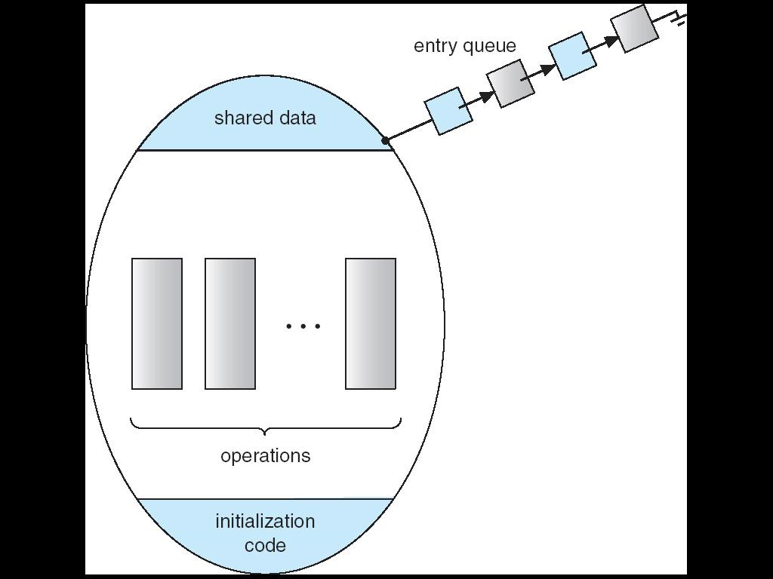
Schematic View of a Monitor

Slide 205
B
C
monitor entry queue:
blocked
blocked
process A
process B
process C
x = x + 1
demo.func1()
y = y – 1;
x1 = x1 - 1
demo.func2()
y1 = y1 + 1;
x2 = x2 - 1
demo.func2()
y2 = y2 + 1;
monitor Demo{
int counter;
counter = 0;
void func1() {
counter++;
}
void func2(){
counter--;
}
}

Slide 206
Monitor (Cont.)
With monitors, programmers do not need to code the synchronization constraint
However, previous monitor is function-limited
Why?
See the following slide

Slide 207
Q: how to allow a process within a monitor to be blocked until some conditions are satisfied?
Sol. Condition Variable
To allow a process to wait within a monitor

Slide 208
Monitors with Condition Variables
condition x, y
Two operations on a condition variable x
x.wait()
Process invoking this operation is suspended
x.signal()
Resume one suspended process.
If no process is suspended, the signal operation has no effect.

Slide 209
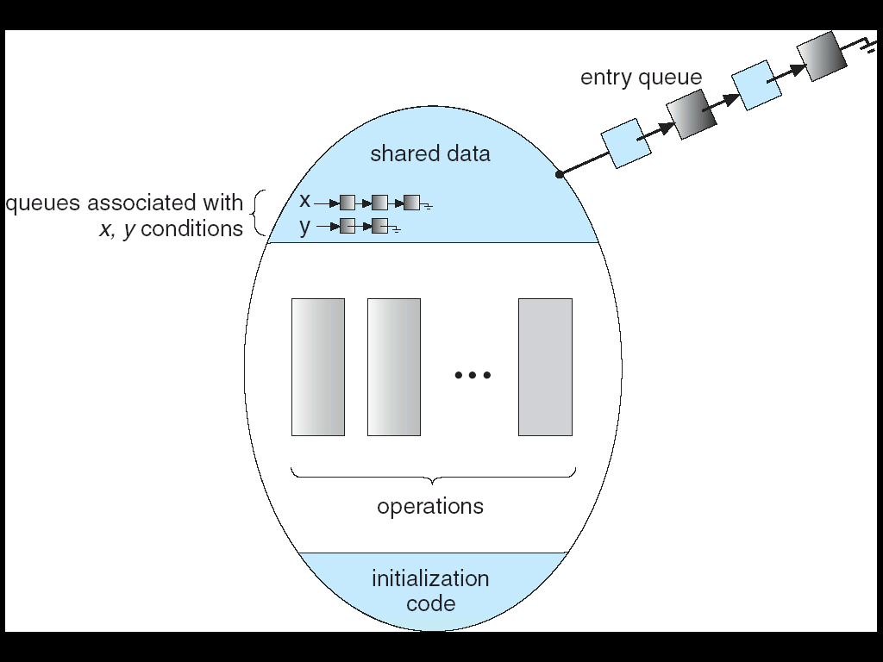
Monitor with Condition Variables
Processes may be
blocked in a monitor

Slide 210
B
C
monitor entry queue:
x.queue:
A
blocked
blocked
process A
process B
process C
x = x + 1
demo.func1()
y = y – 1;
x1 = x1 - 1
demo.func2()
y1 = y1 + 1;
x2 = x2 - 1
demo.func2()
y2 = y2 + 1;
monitor Demo{
int a;
condition x;
a = 0;
void func1() {
if (this.a == 0)
x.wait();
a++;
}
void func2()
x.signal();
a = a + 1;
}
blocked

Slide 211
Q: When B executes x.signal() that wakes up A Now, both B and A are active ⇨ X
Hint: one must wait.

Slide 212
Monitors with Condition Variables (Cont.)
Solution: two possibilities for the implementation:
Signal and wait: B signals and waits
A is active in the monitor
B waits until A leaves the monitor
Signal and continue: B signals and continues
B is still active in the monitor
A waits until B leaves the monitor

Slide 213
Outline
Background
The Critical-Section Problem
Peterson’s Solution
Hardware Support for Synchronization
Mutex Locks
Semaphores
Monitors
Monitor Usage
Implementing a Monitor Using Semaphore
Resuming Processes within a Monitor
Liveness
Lock-free programming
Evaluation

Slide 214
Q: 如何提供(support)Monitor?
Ans: 利用OS提供的synchronization機制(mutex, spin lock, or semaphore)

Slide 215
Q: 觀察一下, 有幾種情形程式會被blocked?

Slide 216
Implement a Monitor Using Semaphores
There are three cases to be blocked in a monitor
Case 1: when entering a monitor
If another process is currently executed in the monitor
Case 2: when calling x.wait(), for each condition variable x
The calling process will be blocked
Case 3: When calling x.signal(), for each condition variable x
Assume that signal and wait
The calling process may wait until the resumed process to leave or wait

Slide 217
Q: 所以, 我們需 要幾種semaphore呢?

Slide 218
Implement a Monitor Using Semaphores (Cont.)
Thus, we need three kinds of semaphore
case 1: use a semaphore mutex (init. as 1) for each monitor
wait(mutex) before entering the monitor
signal(mutex) after leaving the monitor
case 2: each condition variable, x, is implemented by using
x_sem (init. as 0): semaphore corresponds to x
int x_count (init. as 0): number of processes waiting on x_sem
case 3: assume signal and wait, use another semaphore
next (init. as 0): used by a signaling process since it must wait
int next_count (init. as 0): number of processes suspend on next

Slide 219
Q: 誰來提供呢?
Ans: compiler/library

Slide 220
Q: 程式怎麼寫呢?

Slide 221
Implement a Monitor Using Semaphores (Cont.)
Each external (public) procedure F will be replaced by
wakeup a
suspended process
in the monitor
(due to signaling)
wait(mutex);
body of F;
if next-count>0
signal(next);
else
signal(mutex);
compiler
body of F
allow other processes
to enter the monitor

Slide 222
x.wait() and x.signal() Invoke Library------x.wait() and x.signal() are implemented in library
x.wait()
{
x-count++; // a new process is to be blocked on x
if (next-count > 0) // wait up processes that are
signal(next); // suspended in monitor due to signaling operations
else // no process suspended within the monitor
signal(mutex); // allow other processes to enter the monitor
wait(x-sem); // blocked itself on x
x-count--; // wakeup by another process, x-count--;
}
x.signal()
{
if (x-count > 0) // there are processes blocked within the monitor, wake up one
{
next-count++; // the signaling process is blocked in next, assume signal and wait
signal(x-sem); // wait up processes blocked on x
wait(next); // the signaling process is blocked
next-count--; // wakeup by another process, next-count--;
}
}

Slide 223
Example 1: Each external (public) procedure F is replaced
……
x = x + 1;
process A
x = x + 1
demo.func1()
y = y – 1;
wait(mutex);
demo.func1(); //like a critical section
if next-count>0
signal(next);
else
signal(mutex);
compiler
y = y - 1;
……
wait(), signal ()……
OS

Slide 224
Example 2: Each external (public) procedure F is replaced
……
x = x + 1;
process A
x = x + 1
demo.func2()
y = y – 1;
wait(mutex);
demo.func2(); //like a critical section
if next-count>0
signal(next);
else
signal(mutex);
compiler
y = y - 1;
……
wait(), signal ()……
OS

Slide 225
Example 3: x.wait() and x.signal() Invoke Library
x.wait()
{
x-count++;
if (next-count > 0)
signal(next);
else
signal(mutex);
wait(x-sem);
x-count--;
}
x.signal()
{
if (x-count > 0)
{
next-count++;
signal(x-sem);
wait(next);
next-count--;
}
}
library
monitor Demo{
int a;
condition x;
a = 0;
void func1() {
if (this.a == 0)
x.wait();
a++;
}
void func2()
x.signal();
}

Slide 226
在下面的例子中，試試看自行追蹤下列變數的值
mutex = 1 , next = 0, next_count = 0, x_sem = 0, x_count = 0

Slide 227
追蹤下列變數的值
mutex = 1 , next = 0, next_count = 0, x_sem = 0, x_count = 0
B
C
monitor entry queue:
x.queue:
A
blocked
blocked
process A
process B
process C
x = x + 1
demo.func1()
y = y – 1;
x1 = x1 - 1
demo.func2()
y1 = y1 + 1;
x2 = x2 - 1
demo.func2()
y2 = y2 + 1;
monitor Demo{
int a;
condition x;
a = 0;
void func1() {
if (this.a == 0)
x.wait();
}
void func2()
x.signal();
a = a + 1;
}
blocked

Slide 228
Outline
Background
The Critical-Section Problem
Peterson’s Solution
Hardware Support for Synchronization
Mutex Locks
Semaphores
Monitors
Monitor Usage
Implementing a Monitor Using Semaphore
Resuming Processes within a Monitor
Liveness
Lock-free programming
Evaluation

Slide 229
Resuming Processes Within a Monitor
If several processes are suspended on condition x
x.signal() should resume which process
Policies:
FCFS
Priority

Slide 230
作業系統實驗會有一個Java Monitor的實驗

Slide 231
Outline
Background
The Critical-Section Problem
Peterson’s Solution
Hardware Support for Synchronization
Mutex Locks
Semaphores
Monitors
Liveness
Lock-free programming
Evaluation

Slide 232
Liveness
Liveness:
A system must satisfy to ensure processes make progress.
Liveness failure (or liveness hazards (危險)):
Fail to satisfy the liveness property
Example
Indefinite waiting (e.g., starvation)
Deadlock
Priority Inversion

Slide 233
Deadlock
Deadlock – two or more processes are waiting indefinitely for an event that can be caused by only one of the waiting processes
Example: Let S and Q be two semaphores initialized to 1
P₀ P₁
wait (S); wait (Q);
wait (Q); wait (S);
. .
. .
signal (S); signal (Q);
signal (Q); signal (S);
Now, P₀ and P₁ are deadlocked.

Slide 234
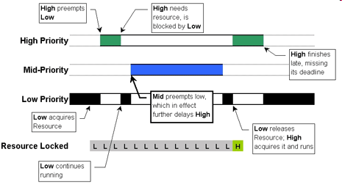
Priority Inversion

Slide 235
Q: Your solution?

Slide 236
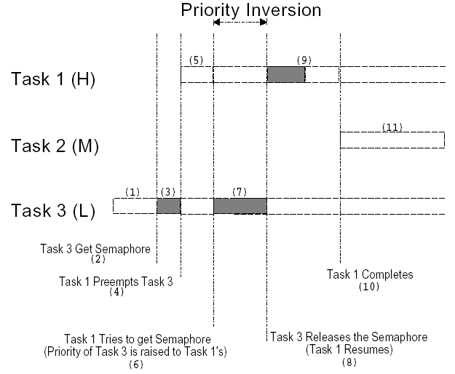
Solution: Priority Inheritance Protocol (PIP)

Slide 237
Outline
Background
The Critical-Section Problem
Peterson’s Solution
Hardware Support for Synchronization
Mutex Locks
Semaphores
Monitors
Liveness
Lock-Free Programming
Evaluation

Slide 238
Lock-Free Programming
Previously, we use compare-and-swap or test-and-set to implement lock-based (mutex, semaphore..) synchronization tools
Recently, a focus on using CAS(compare-and-swap) to construct lock-free programming
Comparisons
Lock-based scheme: an pessimistic scheme
先取得Lock，不管會不會發生race condition
lock-free programming: an optimistic scheme
先執行，如果之後有問題(發生conflict)，則重新嘗試！

Slide 239
Using compare_and_swap to Implement increment()
void increment(atomic_int *v) { int temp; do { temp = *v; } while (temp != (compare_and_swap(v,temp,temp+1)); }
Implementation of increment() operation

Slide 240
複習:compare_and_swap Instruction
Definition.
int compare_and_swap(int *value, int expected, int new_value)
{
int temp = *value;
if (*value == expected)
*value = new_value;
return temp;
}
Done by a single instruction
If the “value” matches “expected”, write “new_value” into value! Finally, return value

Slide 241
Example: *counter = 5, calling increment(), the result is 7
Thread 1 | Thread 2
temp = *v (=counter) = 5 | ---
--- | temp = *v (=counter) = 5
--- | compare_and_swap(v, temp, temp+1); // *v (=counter) = temp+1 = 6; return 5
compare_and_swap(v(=6), temp(=5), temp+1); // *v != temp, v = 6, return 6;
temp != 6; while()成立 (busy waiting)
temp = *v (=counter) = 6
 | temp = 5; return 也是5, while ()不成立
 | increment() 完成 Continue to the following instruction
compare_and_swap(v, temp, temp+1); // *v (=counter) = temp+1=7, return 6;
temp == 6; while ()不成立
increment() 完成 Continue to the following instruction

Slide 242
Outline
Background
The Critical-Section Problem
Peterson’s Solution
Hardware Support for Synchronization
Mutex Locks
Semaphores
Monitors
Liveness
Lock-free programming
Evaluation

Slide 243
Q: 那要使用lock-based scheme或是lock-free programming?
See the following slide

Slide 244
Evaluation
Thus, depend on contention loads
Uncontended: lock-free programming is better
Moderate contention: lock-free programming is better
Using synchronization scheme to acquire a contended lock result in a more time-consuming code path
Suspend a thread, place it on a wait queue, and context switch to another thread
High contention: traditional synchronization methods

Slide 245
Q: 此外, 介紹了這麼多synchronization的方法, 那我們要使用哪一種方法呢?

Slide 246
Evaluation (Cont.)
If using synchronization scheme, when to use which synchronization tool?
Atomic variables are much lighter than mutex or semaphores for single updates to shared simple variables, e.g., integers
Spinlock are used on MP if CS is short
Mutex locks are simpler and less overhead than (binary) semaphores
Counter semaphore is used if controlling access to a number of resources
Read-writer locks are preferred over a mutex lock since it allows a higher degree of concurrency (introduced in Chapter 7)
Monitor and condition variables may have significant overhead

